Slide 1


Knowledge-Grounded Natural Language Processing
Wenhu Chen (wenhuchen@ucsb.edu)
Computer Science Department

Slide 2














Virtual Assistant
What is the average points per game of Lebron in the last NBA season?
Lebron James obtained an average of 25.3 points in L.A. Lakers during 2019-20 season.
World Knowledge
Notes:
I assume that most of you have had some experience with virtual assistant, which you can communicate with using natural language for specific purposes. The virtual assistant needs to take human language as the input, grounding on the external world knowledge to make responses.

Slide 3
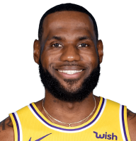
Knowledge-Grounded Understanding
Position | Small forward
Born | 1984, Ohio
reasoning
LeBron Raymone James Sr. is an American professional basketball
player for the Los Angeles Lakers of the National Basketball Association (NBA).
What is the average points per game of Lebron in the last NBA season?
Lebron
Lebron
Lebron
Lebron James Career Statistics
Year | Team | PPG
2016-2017 | Cleveland | 26.4
2017-2018 | Cleveland | 27.5
2018–2019 | L.A. Lakers | 27.4
2019–2020 | L.A. Lakers | 25.3
reasoning
Lebron
Notes:
In order to build a virtual assistant, the model requires knowledge-grounded understanding, i.e. the model needs to understand the semantics of the given natural language input. For example, the model needs to reason over the world knowledge to understand Lebron means Lebron James and last NBA season means 2019-2020 NBA season.

Slide 4
Knowledge-Grounded Generation
Position | Small forward
Born | 1984, Ohio
LeBron Raymone James Sr. is an American professional basketball
player for the Los Angeles Lakers of the National Basketball Association (NBA).
Lebron James obtained an average of 25.3 points in L.A. Lakers during 2019-20 season.
Lebron James Career Statistics
Year | Team | PPG
2016-2017 | Cleveland | 26.4
2017-2018 | Cleveland | 27.5
2018–2019 | L.A. Lakers | 27.4
2019–2020 | L.A. Lakers | 25.3
Lebron
Lebron
Lebron
Notes:
Then the model needs to ground on the supporting knowledge to generate natural language response to generate natural language sentences.

Slide 5

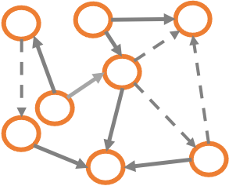





Knowledge-Grounded NLP
What is the average points per game of Lebron in the last NBA season?
Lebron James obtained an average of 25.3 points in L.A. Lakers during 2019-20 season.
Grounded
Understanding
Grounded
Generation
Knowledge Reasoning
Documents
Knowledge Graph
Tables
Charts
Images
Videos
Notes:
Here is a big picture of knowledge-grounded NLP, which can roughly be seen as three aspects: 1) grounded understanding, which takes natural language input and ground it on the external knowledge to understand its semantics, 2) we need to reason over external knowledge to derive the most relevant facts, 3) finally, we will convert the knowledge fact into natural language to communicate with humans.

Slide 6
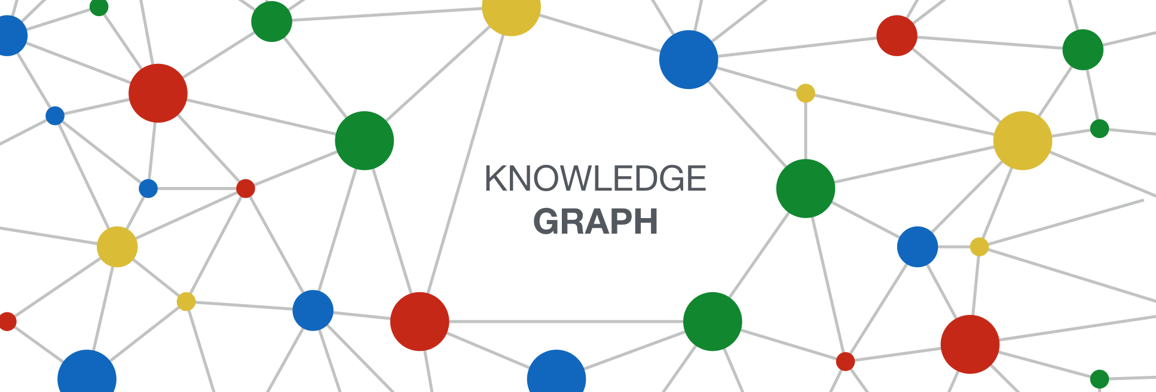

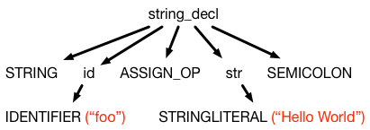


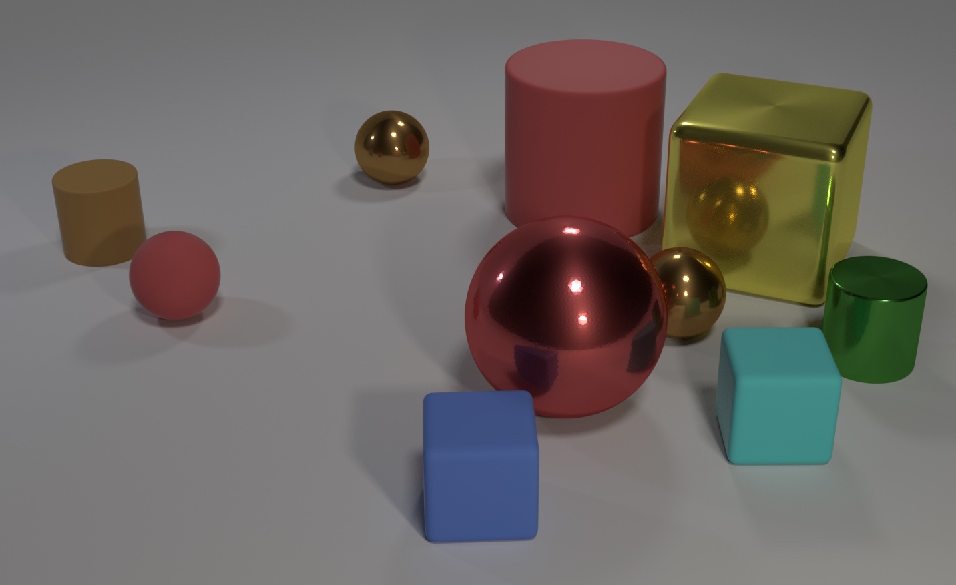
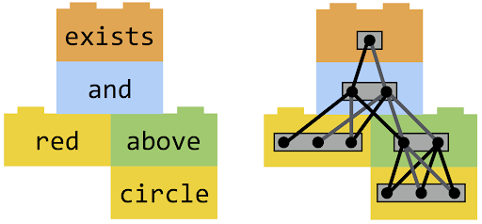


Core Problems (My Interests)
How to reason over world knowledge in different scenarios?
[Chen et al. NAACL18]
[Chen et al. ICLR20, ACL20]
[Chen et al. EMNLP20a, ICLR21]
[Chen et al. CVPR20, WACV21]
How to encode knowledge into NLP models, internalized or externalized?
vs.
[Chen et al. EMNLP20b]
internalized
externalized
Notes:
Throughout my Phd, I have been mainly focused on the two core problems of knowledge-grounded NLP. The first is how to reason over the world knowledge under different scenarios. I have worked on reasoning over KB, database, heterogeneous web data, and visual knowledge like images or videos. The second is how to encode knowledge into NLP model. For example, should we encode knowledge into NLP models in an internalized or externalized fashion. The internalized encoding means we let he model memorize the world knowledge in its parameters while the externalized encoding means that we encode knowledge as an external memory bank, where the model needs to retrieve the knowledge whenever needed.

Slide 7
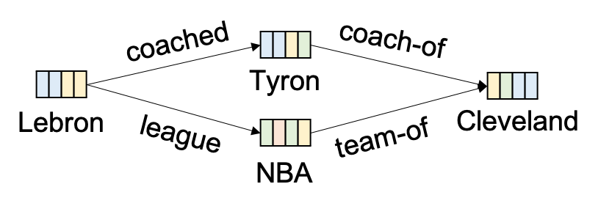
Talk Outline
Reasoning over Knowledge Graph
[Chen et al. NAACL18]
Reasoning over Heterogeneous Web Knowledge
[Chen et al ICLR21]
Externalizing Factual Knowledge in Language Model Pretraining
externalize
[Chen et al. EMNLP20b]
Notes:
I will organize today’s talk with these two core problems, specifically, I will cover how to perform neural symbolic reasoning over KB, how to reason over heterogeneous web knowledge at scale. Finally, I will cover how to externalize factual knowledge in language model pre-training to decrease text generation model’s hallucination behavior.

Slide 8
Talk Outline
Reasoning over Knowledge Graph
[Chen et al. NAACL18]
Reasoning over Heterogeneous Web Knowledge
[Chen et al ICLR21]
Externalizing Factual Knowledge in Language Model Pretraining
externalize
[Chen et al. EMNLP20b]

Slide 9
Simple QA over Knowledge Graph
Which team does Lebron James play for?
Large-Scale Knowledge Graph (Freebase, NELL, YAGO)
Notes:
In this paper, we consider a more realistic setting, where the question is free-form question and the support evidence is the web with massive amount of data in unstructured, semi-structured and structured formats. In such a web-scale setting, we need to design models that can perform efficient inference.

Slide 10
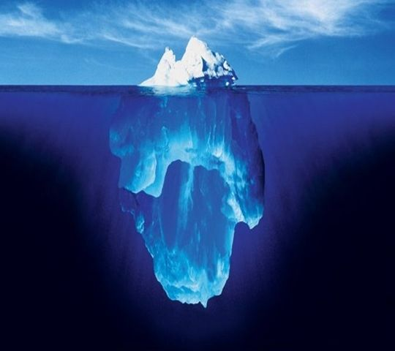
Incompleteness in Knowledge Graph
Freebase, WordNet, ConceptNet
NELL, ClueWeb2009, YAGO
Google Freebase
>95% incomplete Person-Birth-place
>80% incomplete Person-Nationality

Slide 11
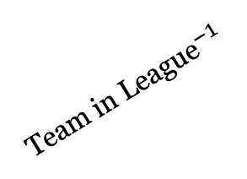
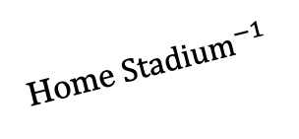
Query over Incomplete Knowledge Graph
Query: (Lebron James, ?, Cleveland Cavaliers)
Tyronn Lue
Coached by
Coach of
Lebron
James
r=PlayFor?
Cleveland
Cavaliers
Play in Stadium
Rocket
Mortgage
Home ${Stadium}^{−1}$
Plays for League
$${\text{Team} \text{in} \text{League}}^{−1}$$
NBA
$${argmax}_{r} p(r|x=\text{Lebron} \text{James}, y=Cleveland Cavaliers)$$
Notes:
How can predict missing fact from existing knowledge?

Slide 12
Symbolic vs. Neural Approach
Symbolic: Soft Logic (Explainability)
$∀x∀y∀z CoachedBy\left(x, z\right)∧$ $CoachOf\left(z,y\right)⇒PlayFor(x,y)$: 80%
$∀x∀y∀z PlayInLeague\left(x, z\right)∧$ $TeamInLeague\left(z,y\right)⇒PlayFor(x,y)$: 20%
Neural: KG Embedding (Generalization)
Lebron James
J.R. Smith
Tyron Lue
NBA
Neural Symbolic (Explainability + Generalization)
coached
coach-of
Tyron
Lebron
league
Cleveland
team-of
NBA
Notes:
In order to perform link prediction in knowledge graph, there are basically two types of approach. One is the symbolic approach like soft-logic, which can lean to deduce first-order logical rule and their associated confidence score to perform explainable reasoning. One is the neural approach like KG embedding achieving state-of-the-art performance due to its strong generalization capability. The neural approach embeds each entity and relation into the vector space and perform implicit reasoning. The goal of this section is to design a neural symbolic approach, which is both explainable and generalizable to large-scale knowledge graph.

Slide 13

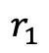
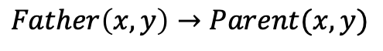
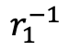
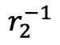
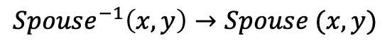
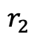
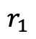
Rule Discovery as Path Finding
Sub-Relation Rule
Expression
$$r_{1}$$
$$Father\left(x,y\right)→Parent(x,y)$$
x
y
Inv-Relation Rule
$$r_{1}^{−1}$$
$${Spouse}^{−1}\left(x,y\right)→Spouse (x,y)$$
x
y
Compositional Rule
x
$$r_{1}$$
z
$$r_{2}$$
y
$$Father\left(x,z\right)∧Father\left(z,y\right)→GrandFather (x,y)$$
Branching Rule
x
$$r_{1}$$
z
$$r_{2}^{−1}$$
y
$$Child\left(x,z\right)∧{Child}^{−1}\left(z,y\right)→Sibling(x,y)$$
Generic Rule
Path Finding
$${L: r}_{1}\left(x,z_{1}\right)∧r_{2}\left(z_{1},z_{2}\right)…∧r_{n}\left(z_{n},y\right)→ ?r(x,y)$$
x
y

Slide 14
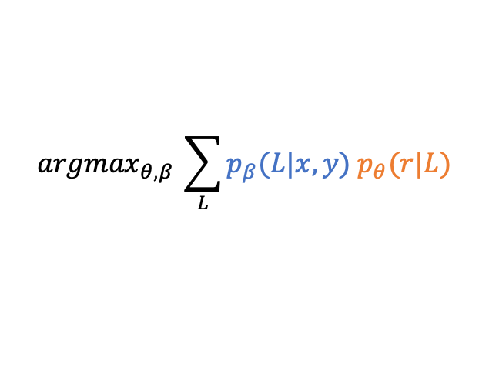
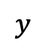
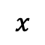
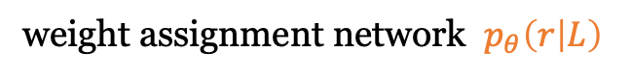
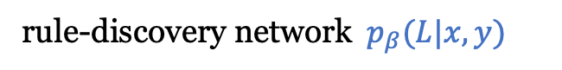
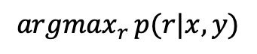
Neural Symbolic Reasoning
weight assignment network $p_{θ}\left(r | L\right)$
20%
Soft Logic
$L: ∀z CoachedBy\left(x,z\right)∧$ $CoachOf\left(z,y \right)⇒PlayFor(x,y)$
rule-discovery network${ p}_{β}(L|x,y)$
$$x$$
$$y$$
KG
$${argmax}_{θ,β }\sum_{L}{p_{β}(L|x,y){ p}_{θ}(r|L)}$$
$${argmax}_{r }p(r|x,y)$$
Logic Rule: L
Notes:
First of all, we rewrite the maximum likelihood problem as a maximum marginal likelihood problem by assuming the compositional logical rules connecting the two entities are the latent variable.

Slide 15

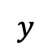
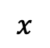
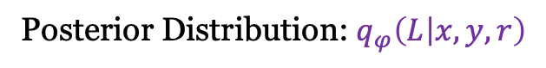
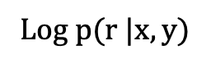
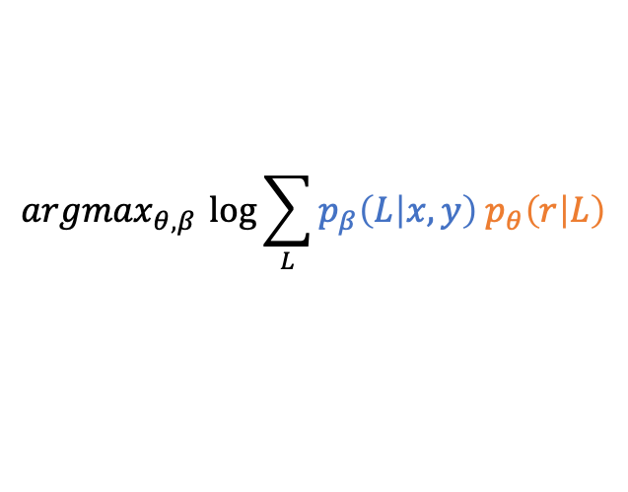
Variational Inference
$${argmax}_{θ,β }\log{\sum_{L}{{p_{β}\left(L | x,y\right) p}_{θ}\left(r | L\right)}}$$
Log p(r |x$,y$)
$$x$$
$$y$$
Intractable!
ELBO
KG
$${{argmax}_{θ,β,φ }[𝔼}_{q_{φ}(L|x,y, r)}log{p_{β}(r|L)}−D_{KL}(q_{φ}\left(L | x,y, r\right)∥p_{β}(L|x,y))]$$
Posterior Distribution: $q_{φ}\left(L | x,y, r\right)$
Notes:
However, it is difficult to directly maximize the marginal likelihood. Exactly computing this marginal likelihood is computationally intractable on large-scale knowledge graph. Therefore, we resort to variational inference framework to maximize its lower bound as the surrogate objective function.

Slide 16
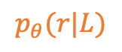
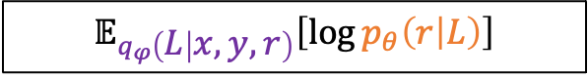
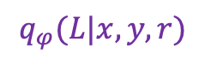
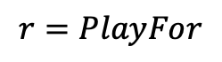
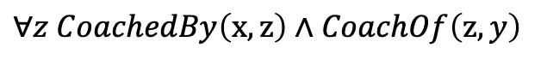
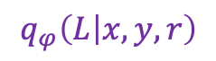
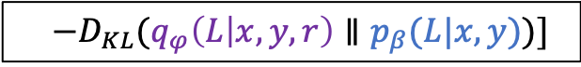
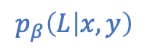
Variational Inference (ELBO)
$$r=PlayFor$$
$$q_{φ}\left(L | x,y, r\right)$$
$$p_{β}\left(L | x,y\right)$$
$$p_{θ}(r|L)$$
$∀z CoachedBy\left(x,z\right)∧$ $CoachOf\left(z,y\right)$
$$q_{φ}(L|x,y, r)$$
$$r=PlayFor$$
Reconstruction Likelihood
KL-Divergence
$$𝔼_{q_{φ}\left(L | x,y,r\right)}\left[\log{p_{θ}\left(r | L\right)}\right]$$
$$−D_{KL}(q_{φ}\left(L | x,y, r\right)∥p_{β}(L|x,y))]$$
ELBO
Notes:
This ELBO consists of two components, one is the reconstruction likelihood and one is the KL-divergence. In the reconstruction …

Slide 17
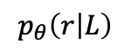
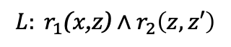
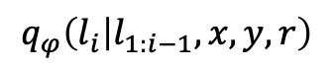
Neural Symbolic Reasoning
- LSTM Rule Discovery (posterior/prior)
$$L: r_{1}\text{(}x\text{,}\text{z}\text{)}∧r_{2}\left(z,z′\right)$$
x
z
z
$$q_{φ}\left(l_{i} | l_{1:i−1},x,y,r\right)$$
z
z
LSTM
x
KG
- CNN Weight Learning (likelihood)
Convolutional
Neural Net
$$p_{θ}\left(r | L\right)$$
L1
L2
L3
Train: Update the neural network parameters to maximize ELBO
Notes:
We parameterize the framework with neural networks. Specifically, the posterior and prior distributions are parametrized as LSTM model … , the likelihood model is parametrized with CNN model ….

Slide 18
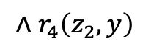
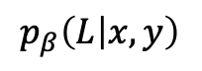
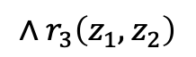
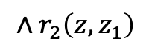
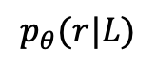
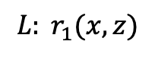
Inference
Play-For: 0.6
Drafted-By: 0.1
Owner-Of: 0.05
Coach-Of: 0.05
……
No-Relation: 0.05
$$p_{θ}(r|L)$$
$$L: r_{1}(x, z)$$
$$∧r_{2}\left(z,z_{1}\right)$$
$$∧r_{3}\left(z_{1},z_{2}\right)$$
$$∧r_{4}\left(z_{2},y\right)$$
$$p_{β}\left(L | x,y\right)$$
0.6
0.9
0.7
0.8
Lebron
James
0.1
Cleveland
Cavaliers
0.1
0.1
Query: (Lebron James, ?, Cleveland Cavaliers)
Notes:
After training, the inference is performed in the following way. We use the prior distribution to traverse the knowledge to discover the most informative logical rules, and then we feed the discovered logical rules to the likelihood distribution to classify them into the most likely relation.

Slide 19
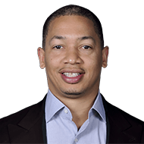

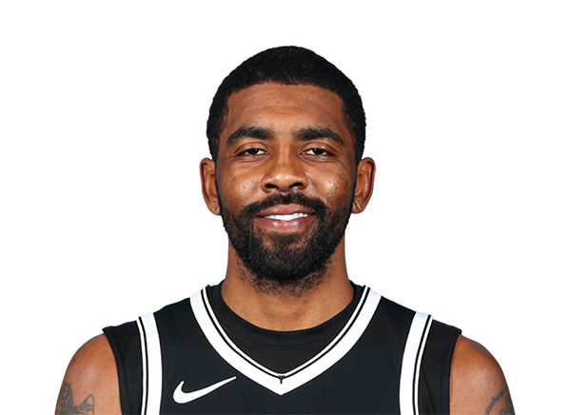

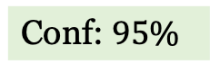
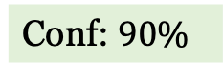
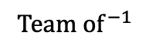

Case Study (Explainability)
$CoachedBy\left(x,z\right)∧$ $CoachOf\left(z,y\right)⇒PlayFor\left(x,y\right)$
Conf: $90\%$
Coached by
Coach of
$$TeamMateOf(x, z)∧PlayFor\left(z,y\right)⇒PlayFor\left(x,y\right)$$
Conf: $95\%$
Teammate Of
Play For
$PlayInLeague\left(x,z\right)∧$ ${TeamOf}^{−1}\left(z,y \right)⇒PlayFor\left(x,y\right)$
Conf: $8\%$
Plays in League
$${Team of}^{−1}$$
Notes:
We evaluate our model to see what kind of soft logical rules it can discover from the NELL knowledge graph. We use the posterior distribution to sample the most likely ones, and less likely ones and unlikely ones …

Slide 20
Experimental Results
Dataset | #Entity | #Relation | #Triple | Task
Freebase | 15K | 237 | 310K | 20
NELL | 75K | 200 | 154K | 12
Link Prediction Tasks
Notes:
We also compare with SOTA models on two popular link prediction datasets, Freebase and NELL, we both outperformed the SOTA models.

Slide 21
Takeaways & What’s Next?
Takeaway:
Ground on explainable logical rules to make decision
SoTA performance on different link prediction datasets
What’s next?
Simple Relation/Entity Question -> Complex Free Question
Incomplete KG -> Massive Heterogeneous Data on Web
Notes:
The takeaway message is that we design a model which is not only able to deduce explainable logical rules, but also generalizable to large-scale KG. However, this section only covers the simple entity/relation-centric questions, what about more complex free questions? We are using KG constructed from Web Data, which is highly incomplete and even out-dated. How can we use massive amount of heterogeneous raw data from the web?

Slide 22
Talk Outline
Reasoning over Knowledge Graph
[Chen et al. NAACL18]
Reasoning over Heterogeneous Web Knowledge
[Chen et al ICLR21]
Externalizing Factual Knowledge in Language Model Pretraining
externalize
[Chen et al. EMNLP20b]
Notes:
Now let’s move on to the second section.

Slide 23




Complex QA over Heterogeneous Web Knowledge
What is the home stadium of Lebron James during NBA season suspended by COVID?
Documents
Lists
Tables
Un-structured
Structured
6,216,701 pages
Notes:
In this section, we considering more complex multi-hop questions and we are using the heterogeneous raw data from the web.

Slide 24



Background: Single-Hop Question Answering
Which NBA season was suspended by COVID?
$$p_{start}$$
$$p_{end}$$
IR
Google BERT
2019–20
The 2019–20 NBA season was the 74th ... The regular season
began on October 22, 2019, and originally …. However, the season was suspended on March 11 as a result of the COVID-19 pandemic.
Notes:
Let me first go over the existing open question answering paradigm, which was mainly focused on only using the unstructured textual data. In this setting, a retriever scans over the web to select the most relevant passage as the support evidence. A reading comprehension model is used to predict the answer span.

Slide 25
Complex Multi-Hop Question Answering
What is the home stadium of Lebron James in the NBA season suspended by COVID?
List of NBA Teams of Lebron James
1
The 2019–20 NBA season was the 74th ... The regular season
began on October 22, 2019, and originally …. However, the season was suspended on March 11 as a result of the COVID-19 pandemic.
2
Year | Team
2012-11 | Miami
2013-14 | Miami
2014-15 | Cleveland
2015-16 | Cleveland
2016-17 | Cleveland
2017-18 | Cleveland
2018–19 | L.A. Lakers
2019–20 | L.A. Lakers
3
The Los Angeles Lakers are an professional basketball team based in Los Angeles. The Lakers compete in the NBA as a member of the league's Western Conference Pacific Division. The Lakers play their home games at Staples Center
Notes:
However, the question might be deemed unanswerable by only looking into a few passages. If we go a extra mile to retrieve tables from the web, we are actually able to answer this given question.

Slide 26


Heterogeneous Information Integration
What is the home stadium of Lebron James in the NBA season suspended by COVID?
Unified QA Model
retrieve
integrate
Answer: 25.3
Challenges
Dataset
Integration
Notes:
The goal of this section is to design a unified reasoning model, which is not only able to understand structured and unstructured data from the web but also able to integrate these two forms of data. Datasets and Efficiency are big issues.

Slide 27


OTT-QA (Open-Table-Text) Dataset
Lebron James Career Statistics
NBA 2018-19 Season
Year | Team | BPG | PPG
2015–16 | Cleveland | .6 | 25.3
2016–17 | Cleveland | .6 | 26.4
2017–18 | Cleveland | .9 | 27.5
2018–19 | L.A. Lakers | .6 | 27.4
2019–20 | L.A. Lakers | .5 | 25.3
NBA 2019-20 Season
Cleveland Cavaliers
L.A. Lakers
NBA 2017-18 Season
(Q, A)
Annotation
Quality Control
OTT-QA
Size: 45K
Model
Human
Notes:
We collected our own dataset called OTT-QA, which consists of table crawling, passage linking. We provide both tables and text to the crowd-workers to let them write Q-A pairs, then we perform model-based and human-based quality control to make sure the questions require information integration and human-based grammaticality and fluency checking. Finally, we harvest a dataset consisting of 45K QA pairs.

Slide 28






Retriever-Reader Framework
Q: What is the home stadium of Lebron James in the NBA season suspended by COVID?
Top-K
Retriever
Reader
Answer
Wikipedia Candidate Pool
$5M$ Passages
$\text{2}\text{M}$ Tables

Slide 29
Multi-Hop Retriever [Baseline]
Q: What is the home stadium of Lebron James in the NBA season suspended by COVID?
BERT Encoder
The 2019–20 NBA season was.... Suspended by COVID-19 pandemic.
1
BERT Encoder
$5M$ Passages
$\text{2}\text{M}$ Tables
Notes:
To learn

Slide 30
Multi-Hop Retriever [Baseline]
Q: What is the home stadium of Lebron James in the NBA season suspended by COVID?
BERT Encoder
Year | Team
2012-11 | Miami
2013-14 | Miami
2019-20 | LA Lakers
2
BERT Encoder
$5M$ Passages
$\text{2}\text{M}$ Tables
Notes:
To learn

Slide 31
Multi-Hop Retriever [Baseline]
Q: What is the home stadium of Lebron James in the NBA season suspended by COVID?
BERT Encoder
3
The Lakers play their home games at Staples Center
BERT Encoder
$5M$ Passages
$\text{2}\text{M}$ Tables
Notes:
To learn

Slide 32

Single-Hop Retriever [Ours]
Q: What is the home stadium of Lebron James in the NBA season suspended by COVID?
BERT Encoder
The Lakers play their home games at Staples Center
Graph Encoder
Teams
Coaches
2019-20
Frank
Stadium
COVD
Suspension
Staples

Slide 33










Full-Attention Reader [Baseline]
$$p_{start}$$
$$p_{end}$$
Google BERT
Complexity:
$$𝒪\left(L^{2}\right)=𝒪\left(K^{2}{\overline{B}}^{2}\right)$$
Slow! Memory Overflow!
$$P_{conf}=98\%$$
$$L=328$$
$$L=442$$
$$L=238$$
$$L=320$$
$$L=K\overline{B}>4000$$
Global context fails to be modeled, local optimum!
$K=50$: number of retrieved block
$\overline{B}≈96$: Average Length per block
Notes:
After we retrieve the top-K candidate blocks, we need to feed them to the neural extractive readers to extract the answer span from the retrieved blocks. However, since we are dealing with significant amount of blocks. If we concatenate all the document, the input sequence length can easily go beyond 4000, which is almost impossible for the reader to handle given its quadratic time complexity. Therefore, the existing frameworks usually decompose the long sequence into a set of smaller groups where each group contains less than 500 tokens. These smaller groups will be fed to the reader in parallel to extract the answer, the one with highest confidence will be used as the final prediction. This framework fails to model global context due to the lack of interaction between different groups, the prediction is basically local optimum.

Slide 34







Global-Local Sparse Attention
Local-Global
$$K^{2}\overline{B}$$
Global-Global
$$K^{2}$$
Global-Local
$$K\overline{B}$$
Local-Local
$$K{\overline{B}}^{2}$$
K Global
$$B_{1}$$
$$B_{2}$$
$$B_{K}$$
Complexity: $𝒪\left(K{\overline{B}}^{2}+K\overline{B}+ K^{2}+K^{2}\overline{B}\right) \sim 𝒪\left(K{\overline{B}}^{2}\right)$
Notes:
We use the global-local sparse attention mechanism to decrease the complexity to KxB^2.

Slide 35

Sparse-Attention Reader [Our Model]
$$p_{start}$$
$$p_{end}$$
Complexity:
$$𝒪\left(\frac{L^{2}}{K}\right)=𝒪\left(K{\overline{B}}^{2}\right)$$
Sparse-Attention
Fast! Memory Efficient!
$$L=K\overline{B}>4000$$
Global context is modeled, global optimum
$K=50$: number of retrieved block
$\overline{B}≈96$: Average Length per block
Notes:
We use the sparse-attention mechanism, we can directly feed all the retrieved blocks to the reader without worrying about the memory overflow and speed. This framework has the advantage that the global context is modeled, the prediction is basically global optimum.

Slide 36

Experimental Results
OTT-QA Test Experimental Results (Accuracy)
27.2%
16.9%
13.4%
9.9%
9.8%
7.2%
4.6%
BM25
Text
BM25
Table
BM25
Hybrid
Multi-Hop
BERT
Single-Hop
BERT
Multi-Hop
Sparse-Att
Single-Hop
Sparse-Att
BM25 Baselines
Xiong et al. 2020
Ours
Single-Hop Retriever: ~8x faster than Multi-Hop Retriever
Sparse-Attention Reader: ~2x faster than BERT Reader
Notes:
We evaluate our model Single-R and Sparse-R on OTT-QA test split and our model is able to achieve significant performance gain. Besides, our model runs much faster than the baseline systems.

Slide 37
Talk Outline
Reasoning over Knowledge Graph
[Chen et al. NAACL18]
Reasoning over Heterogeneous Web Knowledge
[Chen et al ICLR21]
Externalizing Factual Knowledge in Language Model Pretraining
externalize
[Chen et al. EMNLP20b]

Slide 38

Knowledge-Grounded Text Generation
What is the average points per game of Lebron in the last NBA season?
Lebron James obtained an average of 25.3 points in L.A. Lakers during 2019-20 season.
Grounded
Understanding
Grounded
Generation
Reasoning
PPG: 25.3
Notes:
We have discussed about grounded understanding and reasoning over heterogeneous web knowledge to derive the supporting knowledge. The last step is to ground on the supporting knowledge to generate natural language responses to communicate with human.

Slide 39





Knowledge-grounded Generation Datasets
Knowledge
Text
Datasets
Murakami et al. 2017
Aok et al. 2019
chart
report
Liang et al. 2013
Dušek et al. 2018
pair
dialog
Gardent et al. 2017
Chen et al. 2020
Radev et al. 2020
triple
description
Wen et al. 2013
Remi et al. 2016
Chen et al. 2020
Parikh et al. 2020
table
biography
Notes:
There has been a wide spectrum of dataset working on such knowledge-grounded generation datasets, these datasets use different structured knowledge as the input and aim to generate different types of text.

Slide 40



Generative Pretrained Transformer (GPT-2)
Lebron James plays as power forward at L.A. Lakers.
Predict
OpenAI GPT-2
Internalize
World Knowledge
~1B Parameters
Input
Lebron James plays as _ _ _ _ _ _.
Sample
Web Text
Notes:
The state-of-the-art model for addressing these wide spectrum of dataset is called GPT-2, which was pre-trained using all the text from the web. For example, a random sentence is sampled from the web, we feed the prefix of the sentence to the model to let it autoregressively generate the original sentence. What this model does is to memorize/internalize the world world knowledge into its 1B parameters.

Slide 41

Promise and Perils of GPT-2
Human-Written Prompt:
A train carriage containing controlled nuclear materials
was stolen in Cincinnati today. Its whereabouts are unknown.
System Completion:
The incident occurred on the downtown train line, which runs from Covington and Ashland stations.
In an email to Ohio news outlets, the U.S. Department of Energy
said it is working with Federal Railroad Administration to find
the thief.
The incident occurred on the downtown train line, which runs from Covington and Ashland stations.
In an email to Ohio news outlets, the U.S. Department of Energy
said it is working with Federal Railroad Administration to find
the thief.
Hallucination
Notes:
Since GPT-2 has been proposed, it has attracted lots of attention from the community. Here we steal an example from the OpenAI blog, …. . At first glance, the machine generated story looks so real that you couldn’t tell whether it’s true or fake. However, if you google a little about “Cov…”, you will find that it does not exist in the world. It means that the model is really good at hallucinating non-existing facts from the world.

Slide 42
Hallucination[1]: Mis-Memorization
Prefix | Completion
Taylor Swift was born in the year of | 1859
Microsoft was founded by | John McAfee
Christmas is in the month of | October
California is located in the country of | India
Tea was invented in | Russia
100 frequent factual knowledge
probe
Notes:
The hallucination comes from two aspects: 1) mis-memorization, where the model has seen this fact before but cannot memorize it due to the limitation of its parameter capability. …

Slide 43

Hallucination[2]: Stale-Memorization
2017 Corpus
2021
The final MVP Lebron James
led his team Cleveland Cavaliers with a strong comeback ….
Lebron James led his team Cleveland Cavaliers to win the 2020 NBA championship by defeating Miami Heat.
Lebron James was drafted as the first place by Cleveland Cavaliers.
Lebron James brought the champion to Cleveland Cavaliers.
Notes:
Another type of hallucination is stale memorization, where the model was trained on a previous web dump, but lots of the knowledge has changed since then. The model will memorize these stale knowledge, thus causing hallucination consequently.

Slide 44



Internalizing Linguistic & Factual Knowledge
Implicit Linguistic Knowledge
Explicit Factual Knowledge
A ___ has fur
Internalize
Internalize
Notes:
When we look closer to the GPT-2, we found that it’s trying to understand two types of knowledge. One is the implicit linguistic knowledge, like how to compose a natural sentence with the given words. The other part is the explicit factual knowledge, like Bill Gates founded MS, etc. The model aims to internalize both types of knowledge.

Slide 45
Externalizing Factual Knowledge
Implicit Linguistic Knowledge
Explicit Factual Knowledge
A ___ has fur
Internalize
Externalize
Notes:
Since the factual knowledge is infinite and non-static, it’s challenging for the model to internalize them. Therefore, I propose to externalize this part of knowledge.

Slide 46



KGPT (Conditional) Pre-training
Lebron James plays as power forward at L.A. Lakers.
Predict
Graph
Network
KGPT
Ground
Encode
Align
KGPT (100M Parameters)
Input
Lebron James plays as _ _ _ _ _ _.
Sample
Notes:
We modify the pre-training of GPT-2 and propose KGPT using conditional pre-training. We still use the web text as the input to let the model learn how to autoregressively generate a sentence token by token. However, the big difference is that we also feed the most relevant knowledge as additional input for the model to ground on so that the model does not need to memorize all the world knowledge.

Slide 47

Pre-training Corpus Construction
Houston Rockets
Moses Malone, Hakeem Olajuwon, and James Harden have been named the NBA's Most Valuable Player while playing for the Rockets, for a total of four MVP awards.
Moses Malone
Hakeem Olajuwon
query
James Harden
Most Valuable Player
Houston Rockets
Notes:
We traverse the Wikipedia to select the sentences with hyperlinks and use these hyperlinks to request their corresponding entities in WikiData, which is a large-scale knowledge graph maintained by Wikipedia Organization.

Slide 48
Pre-training Corpus Construction
Houston Rockets
Moses Malone, Hakeem Olajuwon, and James Harden have been named the NBA's Most Valuable Player while playing for the Rockets, for a total of four MVP awards.
Moses;Harden;Hakeem
Description: American Basketball Player
Basketball
1956
Harden
award
instance of
sports
inception
awarded
MVP
Hakeem
NBA
plays for
awarded
awarded
Moses
gender
male
Power Forward
position
Filter + De-contamination
KG->Text | #Ent | #Relation | #Triple | Length | #Ent/Sent
7M | 1.8M | 1210 | 16M | 20 | 3.0
Notes:
We merge the facts from WikiData to construct the local knowledge graph. We hope that this local knowledge graph contains enough supportive evidence for the original text. We automatically construct a dataset to perform knowledge-grounded language model pre-training.

Slide 49

KGPT Pre-Training
Conditional
Pre-Training
(KG → Text) Pairs
Pre-trained Model
Notes:
We use the dataset to pre-train the transformer model for a few epochs to get the pre-trained model and we can play with this pre-trained model to compare with GPT-2.

Slide 50

Controlled Generation
Taylor Swift is a female singer born in 1989.
Taylor Swift was born in Pennsylvania, United States.
Taylor Swift published top songs on Billboard Hot.
Both Keith Urban and Taylor Swift are country music singer.
KGPT Sample
Sample
Notes:
Instead of generating text from scratch like GPT-2, we propose controlled generation. If we are interested in generating sentences related to Taylor Swift and sample some ½-hop facts in WikiData about Taylor Swift to construct a local knowledge graph. We provide this knowledge graph to the KGPT to let it randomly sample natural language sentences.

Slide 51
KGPT Down-Stream Transfer
Knowledge-Grounded
Language Model
(KG → Text) Pairs
Pre-trained Model
WikiBio
WebNLG
E2ENLG
Notes:
Furthermore, we can finetune the pre-trained model on down-stream data-to-text datasets to see whether the model can perform transfer learning like GPT-2.

Slide 52
Down-Stream Experimental Results
Full-Shot Experimental Results [BLEU-4]
64.1
w/o Pretrained
61.0
61.3
67.3
67.0
68.1
44.5
44.6
45.2
GPT
KGPT
WebNLG-100%
E2ENLG-100%
WikiBio-100%
Few-Shot Experimental Results [BLEU-4]
40.2
w/o Pretrained
24.5
GPT
22.3
22.5
19.6
8.5
KGPT
4.6
3.5
1.3
WebNLG-0.5%
E2ENLG-0.1%
WikiBio-0.01%
Notes:
We achieve significant performance for both full-shot and few-shot transfer learning settings and outperform GPT-2 by a significant margin.

Slide 53
Faithfulness Evaluation
Human Evaluation Results on WebNLG
92%
85%
79%
w/o Pretrained
18%
GPT
14%
3%
6%
1%
2%
KGPT
Hallucination
Incomplete
Precise
Model | #Param | Fluency | Transfer | Faithful | Diverse | Coverage
GPT-2 | ~1Billion | ✓ | ✓ | ☓ | ✓ | ✓
KGPT | 100M | ✓ | ✓✓ | ✓ | ☓ | ☓
Notes:
We evaluate the faithfulness to see whether the model is able to generate sentences faithful to the world knowledge, it turns out that our model is able to decrease the hallucination by a large margin from 14% to 6%.

Slide 54
Recap
Reasoning over Knowledge Graph
[Chen et al. NAACL18]
Reasoning over Heterogeneous Web Knowledge
[Chen et al ICLR21]
Externalizing Factual Knowledge in Language Model Pretraining
externalize
[Chen et al. EMNLP20b]

Slide 55





Takeaway of KG-NLP
Explicit Knowledge
Tacit Knowledge
Commonsense
Causal Knowledge
World Knowledge
Social Knowledge
Temporal Knowledge

Slide 56


Takeaway of KG-NLP
Explicit → Retrieval + Reading
NLP
Model
Tacit → Memorize + Generalize
Pre-train
Inductive bias
World Knowledge

Slide 57
Future Directions (Explicit Knowledge)
NLP
Model
retrieval
reasoning
Future Directions
Future Directions
How to retrieve more efficiently?
How to retrieve heterogeneous data?
How to make retriever robust
against adversarial information?
How to cope with ambiguous query?
How to reason over long sequence?
How to reason over heterogeneous data?
How to integrate symbolic and neural reasoning frameworks?

Slide 58

Future Directions (Tacit Knowledge)
Pre-train
Inductive bias
Future Directions
How do we evaluate the memorization/generation performance?
How can we better represent the tacit knowledge?
How can we improve the pre-training to better memorize tacit knowledge?

Slide 59

Thank you!

